Slide 1
FlatIron Phase 3 Power point presentation
Henry Chung

Slide 2
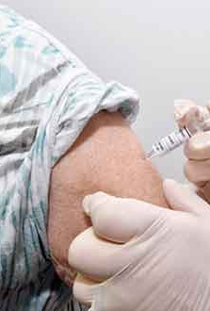
Business Understanding
Stake Holder: New York State Department of Health wants to increase public H1N1 vaccination rate
Objective: Increase public vaccination rate with stronger public health efforts by understanding people’s background, opinions, and health behaviors.
This Photo by Unknown Author is licensed under CC BY-NC

Slide 3

Data Source – and processing
26707 of survey data is collected in the National 2009 H1N1Flu survey is used.
37 features are included in the dataset, but the seasonal flu data ( 3 features) were not used in this study.
Target variable = people get H1N1 vaccine.
around 21% is vaccinated with H1N1 vaccine
This Photo by Unknown Author is licensed under CC BY-ND

Slide 4
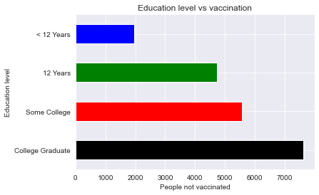

EDA ANALYSIS

Slide 5

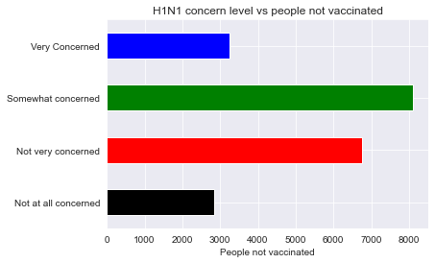
EDA analysis
This Photo by Unknown Author is licensed under CC BY-NC

Slide 6

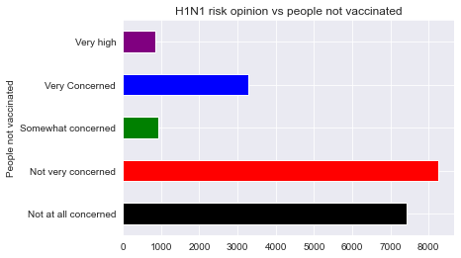
EDA ANALYSIS
This Photo by Unknown Author is licensed under CC BY-SA-NC

Slide 7

Road Map for this study
Split the data into 75%-25%
Data Cleaning
Implement model and pipeline
Finding optimum hyperparameters
Model evaluation and recommendation
This Photo by Unknown Author is licensed under CC BY-SA

Slide 8
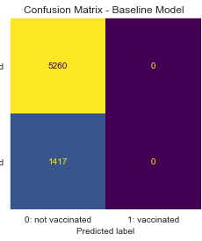
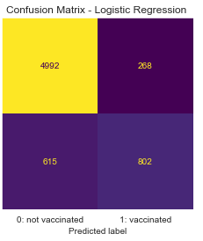
Best Model
Logistic Regression
Precision
Positive case (0 % to 75%)
Negative case(79% to 87%
Accuracy
Improve the score from 78% to 87%

Slide 9
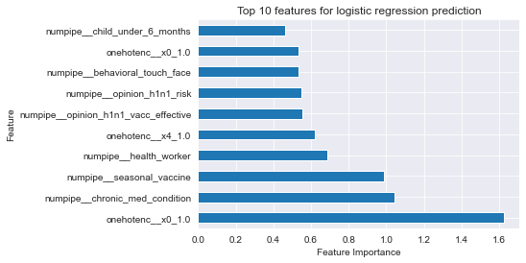

Top 10 Features For the model

Slide 10

Conclusion/Recommendation
People care !!! People who are more aware of their health situations are likely to get vaccinated.
Promote H1N1risk without vaccine.
Target college level people with proper H1N1 knowledge.
This Photo by Unknown Author is licensed under CC BY-SA-NC

Slide 11


Next Step
Investigate employment status and employment occupation and vaccination rate.
Investigate with advanced models
This Photo by Unknown Author is licensed under CC BY-ND

Slide 12
Thank You

